Slide 1

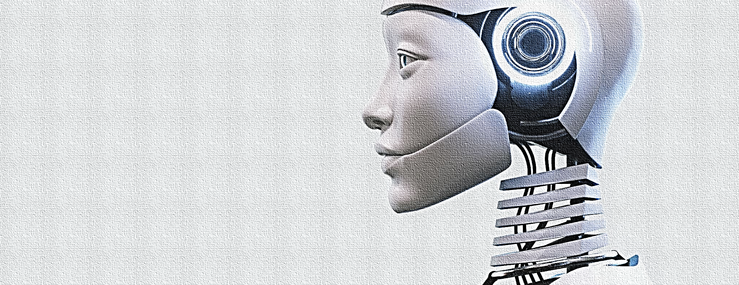
AI-Powered Chatbot for Personalized Learning
Brandon Summerlin | Spring 2025

Slide 2
Introduction:
A personalized AI tutor designed to teach Python and Guitar Music Theory.
Powered by Ollama using LLaMA 3, DeepSeek Coder v2, and Mistral.
Local-first design for privacy, speed, and control.

Slide 3
Key Features:
Adaptive explanations and multi-turn dialogue
Visual chord diagrams using matplotlib
Quiz generation with difficulty tracking
Gradio UI with model-switching dropdown

Slide 4

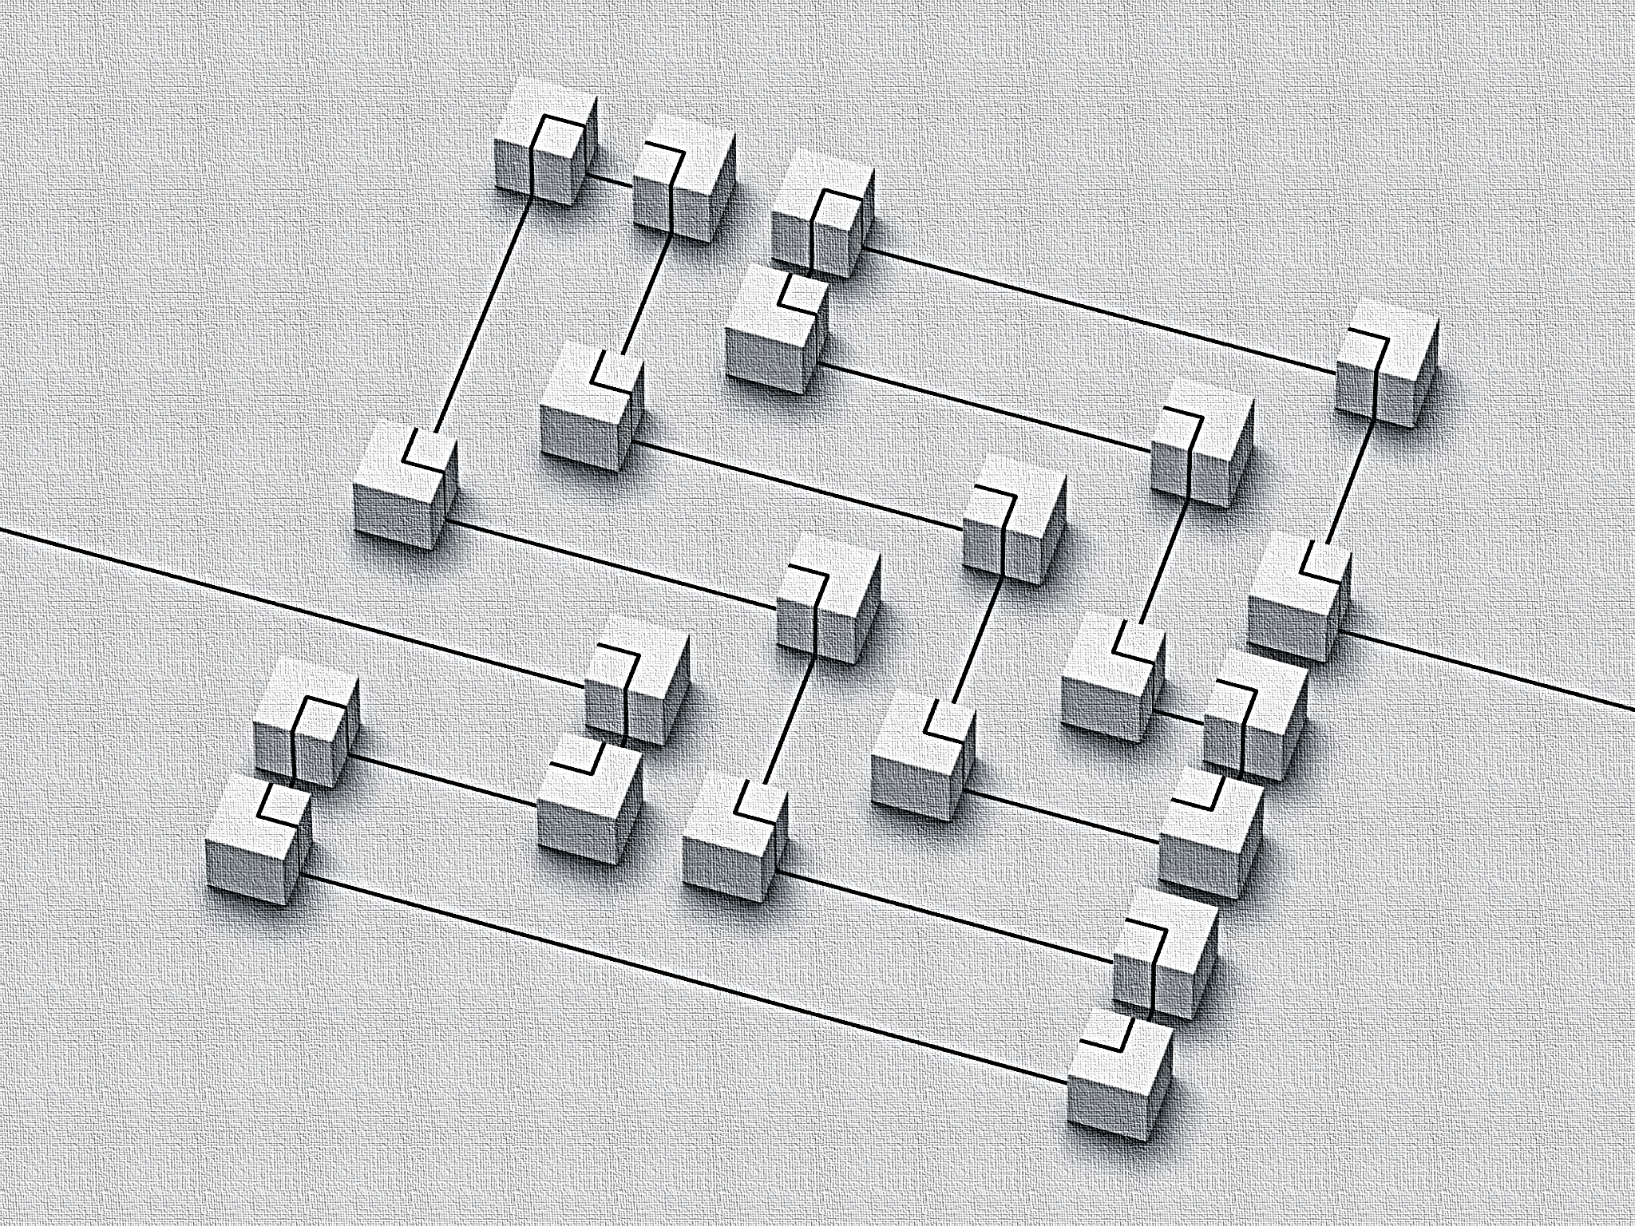
Architecture Overview:
Built with Python + Gradio frontend
Three-model routing logic via Ollama
Persistent memory stored in JSON files
Diagram generation from structured chord dictionary

Slide 5
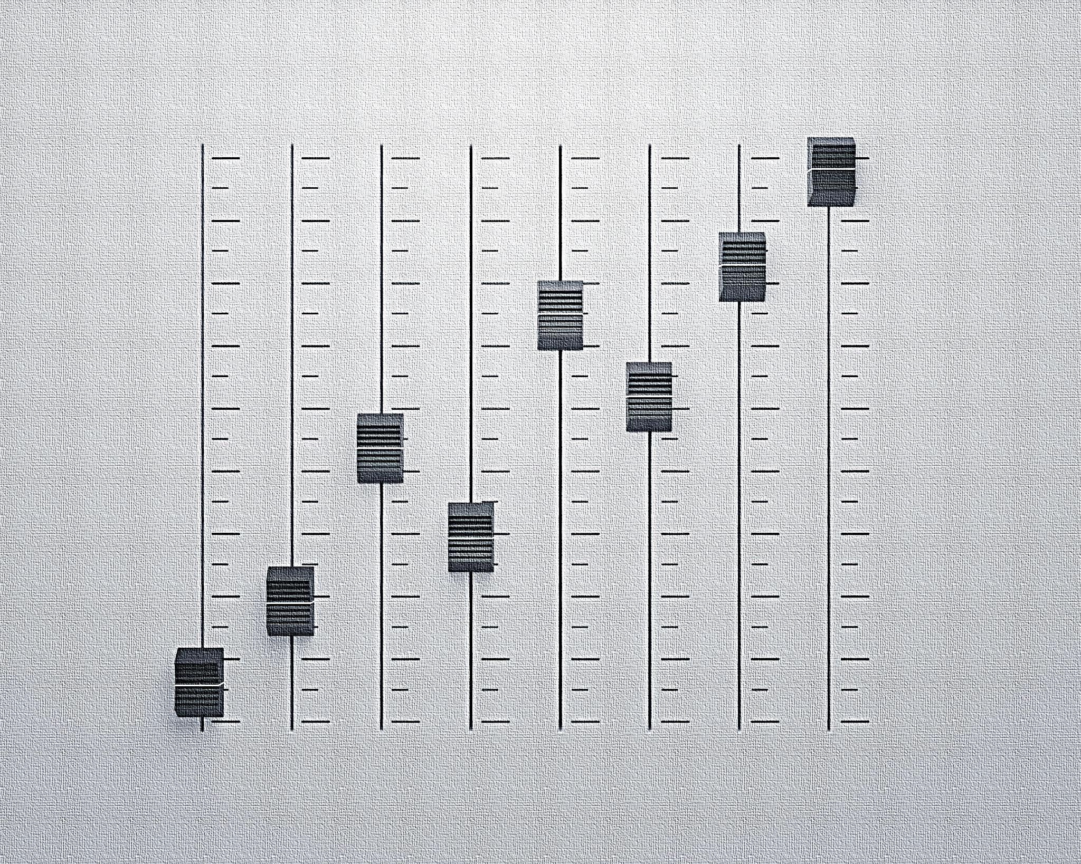
User Experience:
Simple Gradio chat UI with live response streaming
Automatic chord rendering based on prompts
Selectable subject model for personalized help
Session logs saved for review and progress

Slide 6
Technologies Used:
Ollama (local model runner)
LLaMA 3, DeepSeek Coder v2, Mistral
Gradio, Python, Matplotlib, JSON
Custom quiz engine and memory tracking

Slide 7

Challenges & Solutions:
✅ Integrated 3 models with routing logic
✅ Resolved diagram rendering in streamed chat
✅ Managed memory efficiently for quiz retry logic
✅ Ensured low-latency local inference with Ollama

Slide 8
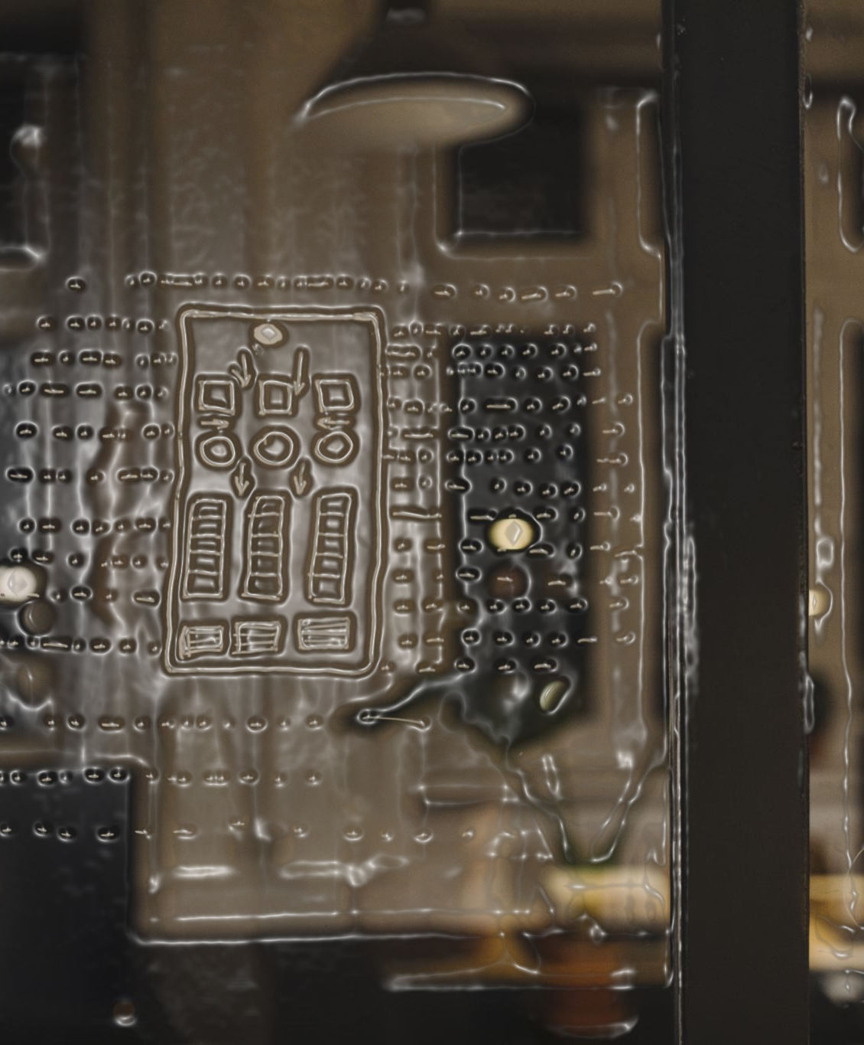
Demo:
Sample tutoring sessions and chord visuals shown here

Slide 9
Conclusion:
Shows potential of adaptive, multi-domain AI tutoring
Fully offline and privacy-respecting
Ready for future subjects like math, science, and writing

Slide 10

Thank You:
Questions?

